Slide 1


Agile Process & Methodologies
www.tothenew.com

Slide 2



Talking Points
SDLC
Why do we need Agile?
Introduction to Agile
Scrum
Q & A
www.tothenew.com

Slide 3
SDLC - Overview
The Software Development Life Cycle is a systematic process for building software that ensures the quality and correctness of the software built. SDLC process aims to produce high-quality software which meets customer expectations. The software development should be complete in the pre-defined time frame and cost.

Slide 4
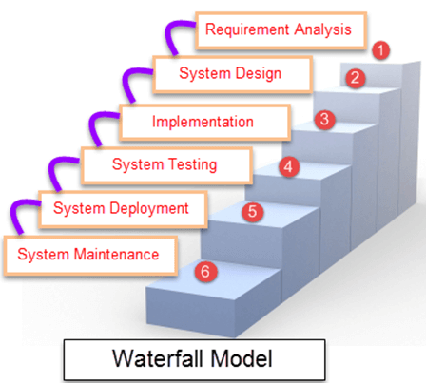
SDLC - Waterfall Model
Waterfall Model is a sequential model that divides software development into different phases. Each phase is designed for performing specific activity during SDLC phase.

Slide 5
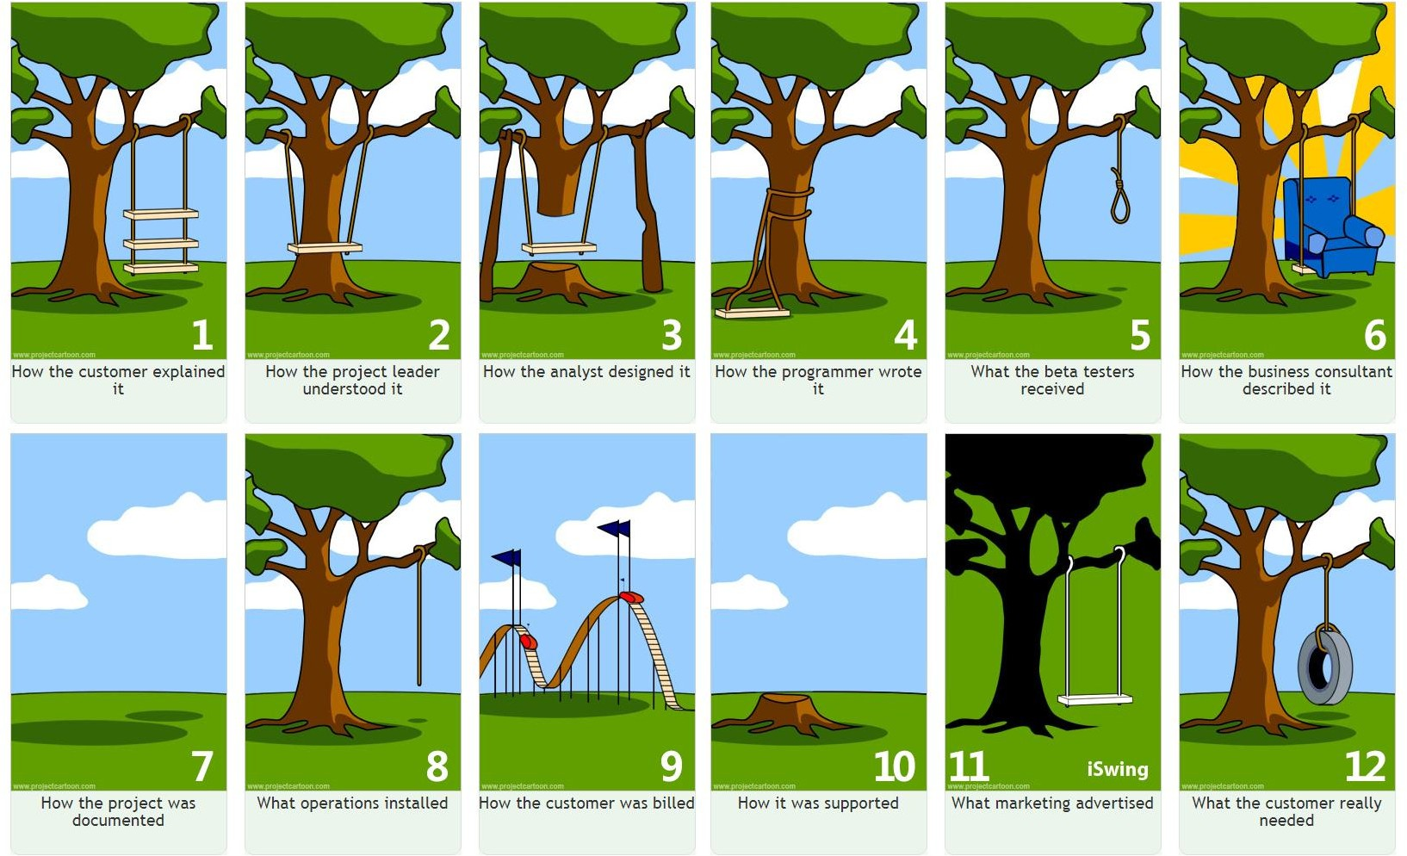
Why do we need Agile?
www.tothenew.com

Slide 6
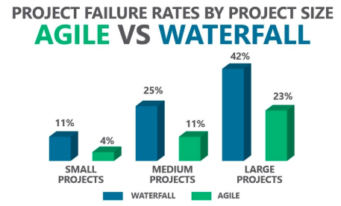
Why do we need Agile?
www.tothenew.com

Slide 7
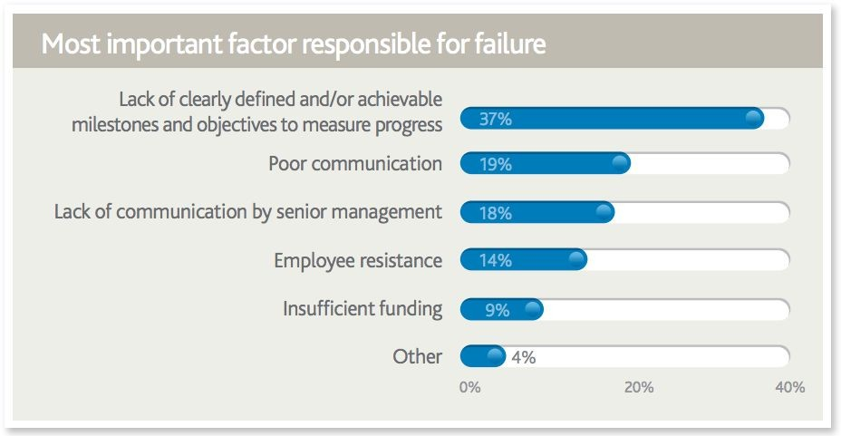
Why do we need Agile?
Source: Pulse of the Profession 2017
www.tothenew.com

Slide 8
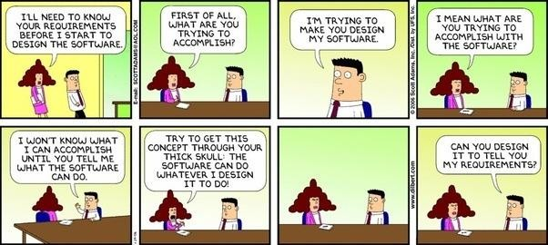
Software Development is Complex
www.tothenew.com

Slide 9
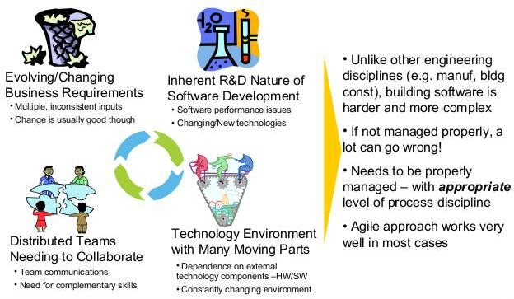
Software Development is Complex
www.tothenew.com

Slide 10

Talking Points
Why do we need Agile?
Introduction to Agile Scrum Q & A
www.tothenew.com

Slide 11
Introduction to Agile
Agile is a mindset that adheres to the principles of the Agile Manifesto.
We are uncovering better ways of developing software by doing it and helping others do it. Through this work we have come to value:
Individuals and interactions over processes and tools Working software over comprehensive documentation Customer collaboration over contract negotiation Responding to change over following a plan
That is, while there is value in the items on the right, we value the items on the left more.
Manifesto for Agile Software Development, www.agilemanifesto.org
www.tothenew.com

Slide 12
Principles behind Agile Manifesto
1
Our highest priority is to satisfy the customer through early and continuous delivery of valuable software.
2
Welcome changing requirements, even late in development.
3
Deliver working software frequently, from a couple of weeks to a couple of months, with a preference to the shorter timescale.
4
Business people and developers must
work together daily throughout the project.
5
Build projects around motivated individuals. Give them the environment and support they need, and trust them to get the job done.
6
The most efficient and effective method
of conveying information to and within a development team is face-to-face conversation.
www.tothenew.com

Slide 13
Principles behind Agile Manifesto
Agile processes promote sustainable development. The sponsors, developers, and users should be able to maintain a constant pace indefinitely.
7 8
Working software is the primary measure of progress.
9
Continuous attention to technical excellence and good design enhances agility.
10
Simplicity--The art of maximizing the amount of work not done--is essential.
11
The best architectures, requirements, and designs emerge from self-organizing teams.
12
At regular intervals, the team reflects on how to become more effective, then tunes and adjusts its behavior accordingly.
www.tothenew.com

Slide 14
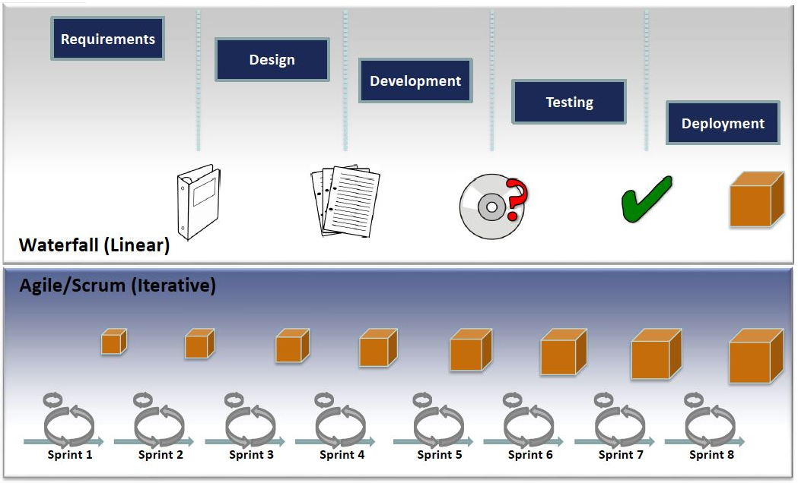
Linear vs. Iterative process
www.tothenew.com

Slide 15
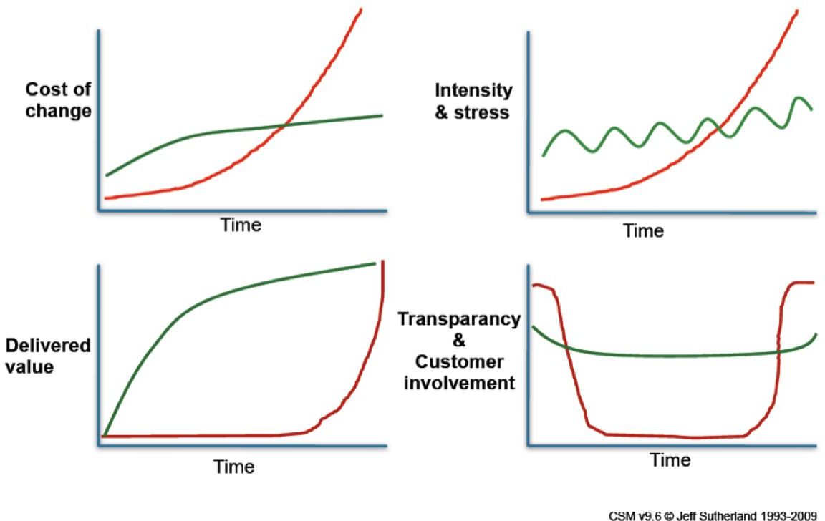

Characteristics of Agile vs. Waterfall
www.tothenew.com

Slide 16

Talking Points
Why do we need Agile? Introduction to Agile
Scrum
Q & A
www.tothenew.com

Slide 17
What is Scrum?
Scrum is a team-based empirical process to incrementally develop products.
www.tothenew.com

Slide 18

Scrum Values
Commitment
Courage
Focus
SCRUM
Values
Openness
Respect
www.tothenew.com

Slide 19

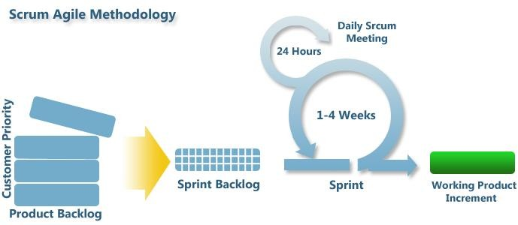
Scrum Process
15 minutes Daily Scrum Meeting
Team members describe:
What did you accomplish yesterday?
What will you accomplish today?
Are there any impediments or risks in your way?
www.tothenew.com

Slide 20
Scrum - Working Agreement - Possibilities
Show Respect: Don’t interrupt; let people finish what they’re saying. It’s OK to disagree with each other. No personal attacks, attack issues, we debate the merit of ideas, not people.
Contribution: Everyone has equal voice and valuable contribution.
Meeting - Be on time, end on time, have an agenda.
Decision Making – We make decisions together.
Be transparent - No hidden agendas. We will give feedback, we will receive feedback, and we will act on feedback.
Impediments - Solve roadblocks within the team. If the impediment can’t be solved within the team, give it to the Scrum master.
Commitment - We make commitments as a team. We will be held accountable to our commitments. We work as a team to make a commitment and deliver on it.
Incomplete stories are not good – it is better to help get an existing story to “done” than to start another story that can’t be finished in the current sprint.
Communication – We communicate using high-fidelity communication mediums.
www.tothenew.com

Slide 21
Scrum - Roles and Artifacts
Roles
Team
Scrum Master
Product Owner
Artifacts
Product Backlog
Sprint Backlog
Product Increment
Events
Sprint (1-4 weeks)
Sprint Planning Meeting (before each sprint - 2hrs/week)
Daily Scrum/Standup Meeting (15 mins)
Sprint Review Meeting / Sprint Demo (Just before sprint end - 1hr/week)
Sprint Retrospective Meeting (after each sprint - 1hr/week)
Backlog Grooming/Refinement meeting (before each sprint - 1hr/week)
www.tothenew.com

Slide 22
Scrum - Roles
Product Owner
Is Team’s sole source of truth for requirements and priorities
Owns requirements (new features, bug fixes) and ranking
Works with customers, stakeholders to define & rank user-facing features
Collaborates with Team to ensure proper implementation
Often a Product Manager, Business Analyst
Scrum Master
Does whatever is needed to make Team as productive as possible
Acts as Servant Leader
Owns process (enforces, tracks, expedites problem resolution)
Runs Daily Stand-Up, Sprint Planning, Retrospective Meetings
Often a Project Manager
Team
5-9 people
Self-organizes cross-functional members to implement, test features
Software & test engineers, database architects, UI developers, etc.
Owns estimates, tasks, assignments
www.tothenew.com

Slide 23
Scrum - Artifacts
Product Backlog Simplest definition - “A list of all things that needs to be done within the project”. It replaces the traditional requirements specification artefacts. These items can have a technical nature or can be user-centric e.g. in the form of user stories. The Scrum Product Owner uses the Scrum Product Backlog during the Sprint Planning Meeting to describe the top entries to the team. The Scrum Team then determines which items they can complete during the coming sprint.
Sprint Backlog Sprint Backlog contains all the committed Stories for the current Sprint broken down into Tasks by the Team. All items on the Sprint Backlog should be developed, tested, and integrated as per “Definition of Done” to fulfil the commitment.
Product Increment Product Increment is the sum of all completed product backlog items in a given sprint, plus the value of previous increments. Output: A working, tested shippable product
www.tothenew.com

Slide 24
Scrum - Events
Ceremony Time Box
Input
Output
Value
Backlog Refinement
Draft User Stories, Epics from Product Owner
Finalized User Stories Technical Stories Ranking for top PBIs
Sprint Backlog
Product Backlog and Team is ready for Sprint Planning
1hr/week
Ranked Product Backlog with Acceptance Criteria
Selected stories + estimates
Tasks + estimates
Team has a plan to implement Sprint Backlog
Sprint Planning
2hr/week
Tasks updated
Impediments Raised
Team on same page: Sprint Progress and Impediments
Daily Stand-up
15min
In-progress Tasks
Demo prepared for completed stories
New Stories, based on review by PO. Ranking may be revised
Ensure appropriateness of deliverables
Sprint Review
1hr/week
Things which we should:
Start Doing
Stop Doing
Continue Doing
Shortlist of improvements for next sprint with owners
Learn from experience, enable continuous improvement
Retrospective
1hr/week
www.tothenew.com

Slide 25







Scrum Process
Daily Scrum Meeting
<15min
Sprint 1,2,3...n
Sprint Planning
Preparation
Business case and funding
Contractual Agreement
Vision
Initial Product Backlog
Initial Release Plan
Stakeholder buy-in
Assemble Team
Product
Product
Backlog
Increment
Release n
SCRUM
Process
Sprint
Sprint Review
Retrospective
www.tothenew.com

Slide 26
Scrum Process - Preparation
Product Owner Prepares the first sprint:
Talks to stakeholders to form a vision of the product
Arranges stakeholder buy in
Gathers high level features
Creates initial product backlog
Creates rough release plan
Planning??
How do you plan a Vacation/Trip?
What all things you will consider while planning for a vacation/trip?
Sample Project Plan
www.tothenew.com

Slide 27
Scrum Process - Product Backlog & User Stories
Product Owner own and prioritize this:
Prioritize list of features and work
Estimated in how much work it will take relative to each other
User Stories
A user story describes functionality that will be valuable to either a user or purchaser of a system or software.
Business writes user stories like:
As a [stakeholder] I want to [feature] so that [business value]
www.tothenew.com

Slide 28
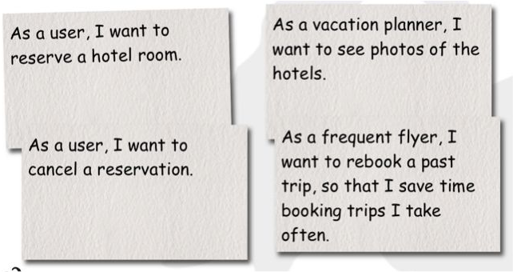
Scrum Process - User Stories
Examples of a User Story:
www.tothenew.com

Slide 29
Scrum Process - User Stories
Good Stories should be:
Independent Negotiable Valuable Estimable Sized Appropriately Testable
www.tothenew.com

Slide 30
Scrum Process - Sprint Planning
Planning Meeting
Set up Sprint goals
Select User Stories for the sprint
Product owner sets sprint goal and clarifies requirements
Team commits to set of user stories based on its velocity
Velocity
Velocity is a measure of the amount of work a Team can tackle during a single Sprint and is the key metric in Scrum.
www.tothenew.com

Slide 31
Scrum Process - Estimations
Planning Poker:
Involves all team members
Each has deck of cards: e.g. 0, ½, 1, 2, 3, 5, 8, 13, 20, ?
Product owners explains user story and answers any questions
Each team member picks his card
Discuss different estimates
Re-estimate -> Converge (meet at a point)
www.tothenew.com

Slide 32
Scrum Process - Product Increment
Product Increment is the sum of all completed product backlog items in a given sprint, plus the value of previous increments.
At the end of a Sprint, the new Increment must be "Done," which means it must be in useable condition and meet the Scrum Team’s definition of "Done"
The increment is a step toward a vision or goal.
The increment must be in useable condition regardless of whether the Product Owner decides to release it.
www.tothenew.com

Slide 33
Scrum Process - Daily Scrum Meeting
Should be of maximum 15 mins at same time and same place
Broadcast individual updates to everyone
It’s not a status check-up meeting: Team member making commitments in front of peers
No Problem Solving should happen in this meeting
Team members describe:
What did I get DONE yesterday?
What will I get DONE today?
Any impediments blocking me?
Sample Video: https://youtu.be/q_R9wQY4G5I
www.tothenew.com

Slide 34
Scrum Process - Sprint Review
Also known as ‘the demo.
Team presents what is accomplished during the sprint
NO SLIDES
Get feedback from the customer/stakeholders
Feels great if they like it
Get immediate response/feedback
www.tothenew.com

Slide 35
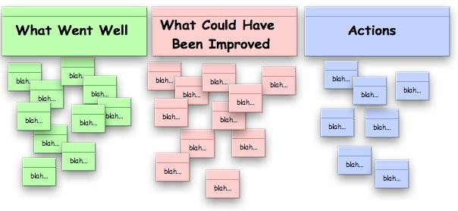
Scrum Process - Sprint Retrospective
How can we improve our way of working?
Things which we should:
Start Doing
Stop Doing
Continue Doing
Action Item from
Previous Retro
Current Retro
www.tothenew.com

Slide 36
Scrum Process - Release
A working, tested shippable product
www.tothenew.com

Slide 37

Q & A
www.tothenew.com

Slide 38
Thank You!
www.tothenew.com

